Slide 1
Forecasting Models

Slide 2

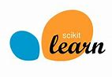


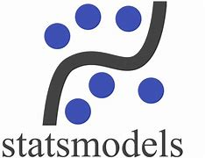
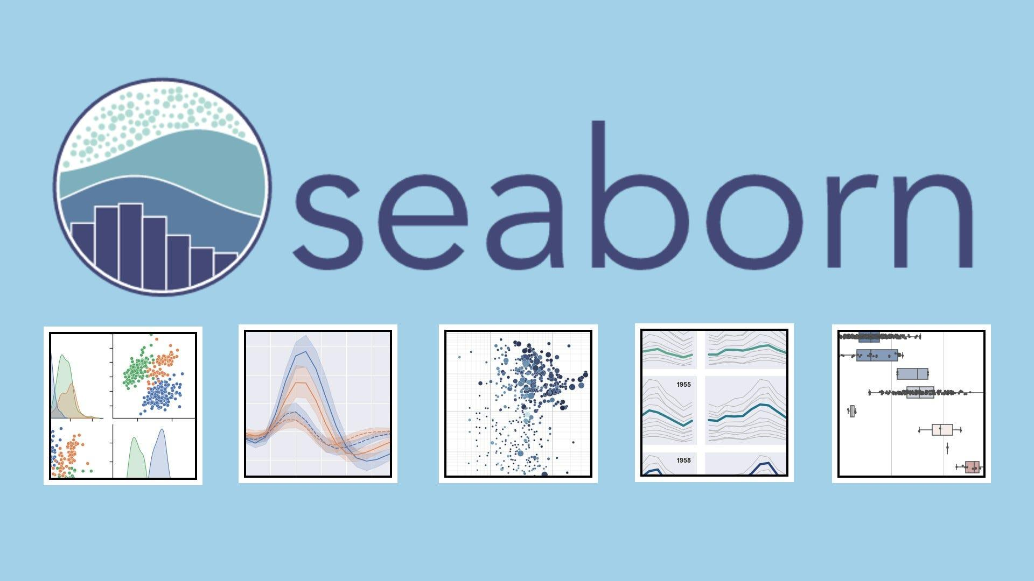
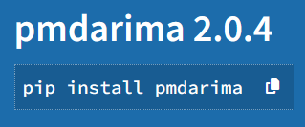
Technologies Used

Slide 3
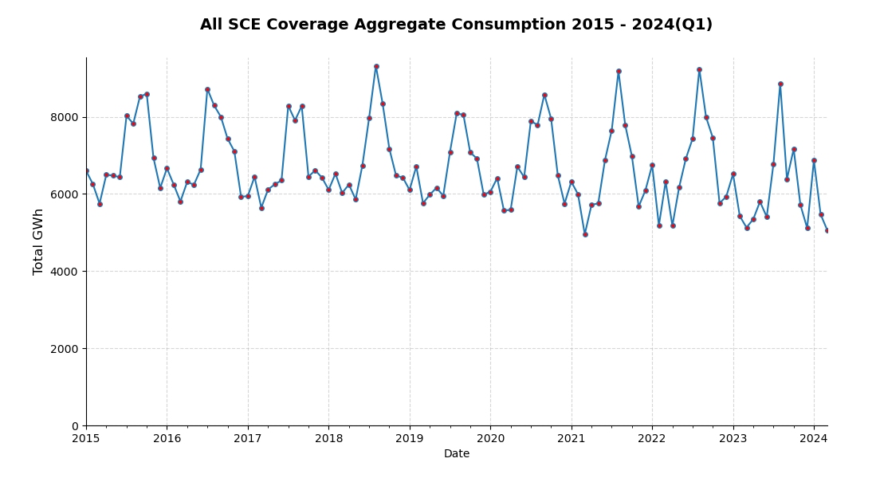
Let’s Take A Look At The Past…
Data Source: SCE Quarterly Energy Data Reports

Slide 4
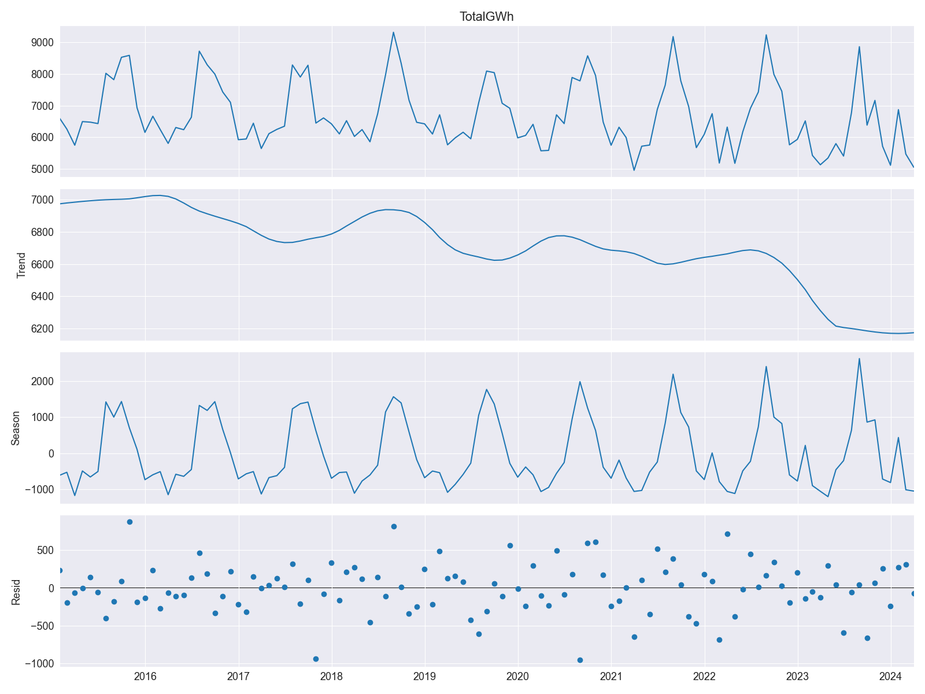
Time-Decomposition
Overall decreasing trend in energy consumption from all areas covered by SoCal Edison
Monthly seasonal peaks and lows in energy consumption
Residuals (noise) in data shows unbiased pattern, so no skewing towards a certain behavior

Slide 5
SARIMAX
Seasonal Autoregressive Integrated Moving Average
with Exogenous Regressors
A statistical model designed to capture and forecast the underlying patterns, trends and seasonality in time-series data.
A powerful time series forecasting technique that extends the traditional ARIMA model to account for seasonality and external factors.

Slide 6
Components
Seasonal (S) | Periodic patterns in data (weekly, monthly, annually, e.g.)
Autoregressive (AR) | Represents relationship between current and previous values in the data
Integrated (I) | Differencing to make data stationary by removing trends and seasonality
Moving Average (MA) | Accounts for dependency of current value on past error terms, used to calculate trend
Exogenous Regressors (X) | Allows inclusion of external factors that may affect data

Slide 7
SARIMAX Parameters
p
d
q
P
D
Q
s/m
Autoregressive Order
Differencing Order
Moving Average Order
Seasonal Autoregressive Order
Seasonal Differencing Order
Seasonal Moving Average Order
Seasonal Period

Slide 8
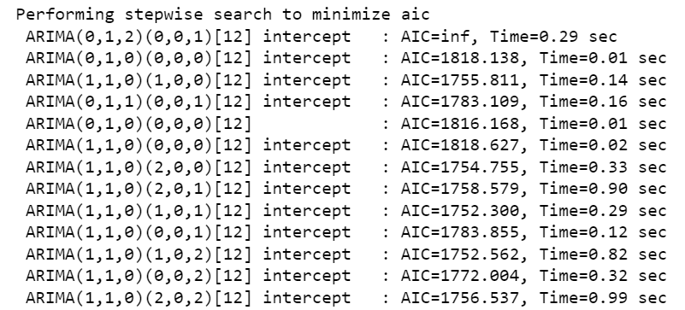
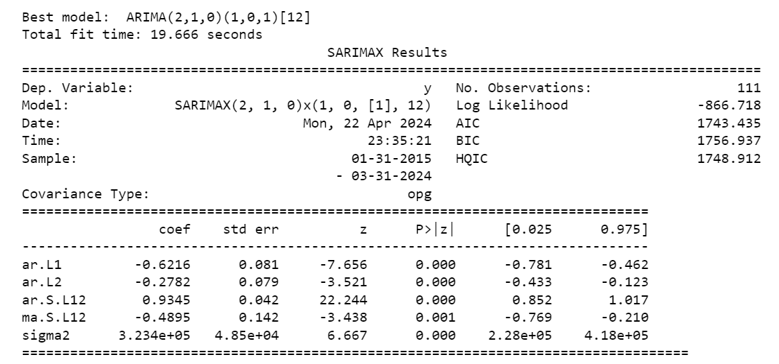
AutoArima To Find Optimal Model Parameters

Slide 9
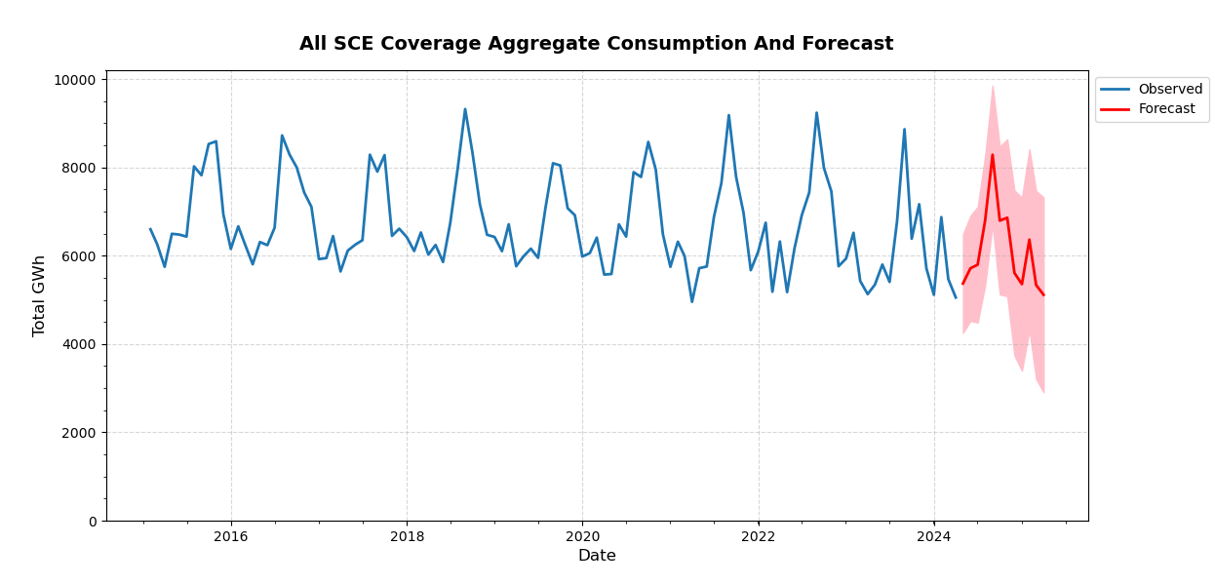
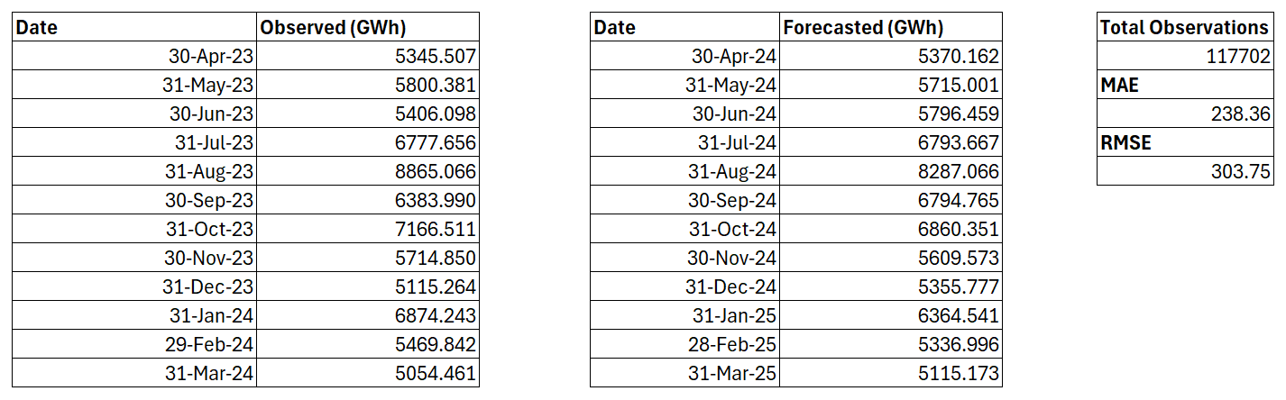
Total Observed | 73,973.87
Total Forecasted | 73,399.53
Difference | - 0.78 %

Slide 10
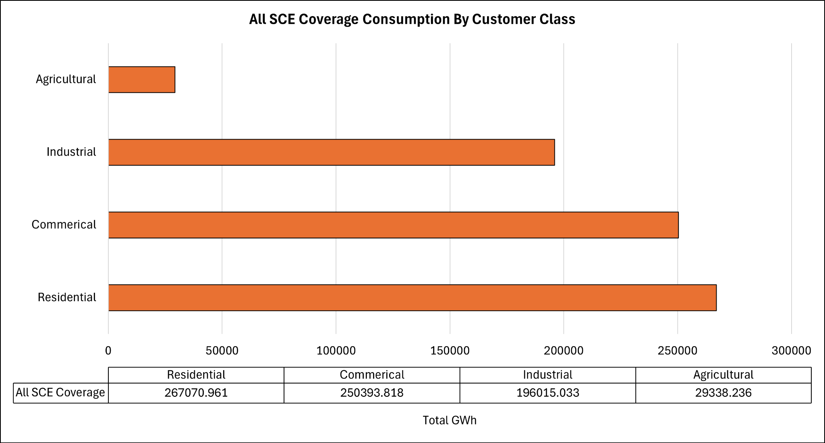

Slide 11
County Forecasts
Predicted Consumptions with Error Values
Projected Percentage Change Based On Forecasted Period

Slide 12
Zip Codes
Counties
Mapped + Grouped to their associated Counties
Data Source: California ZIP Codes List, Map, and Demographics (unitedstateszipcodes.org)

Slide 13
Counties With A Projected Usage Increase

Slide 14
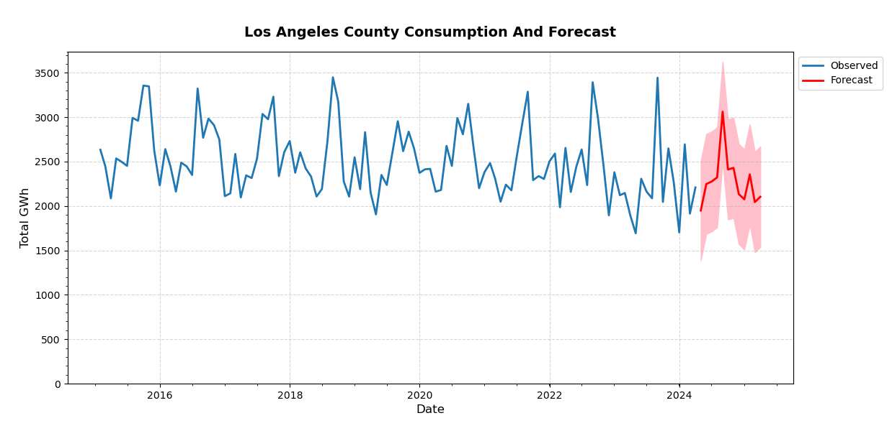
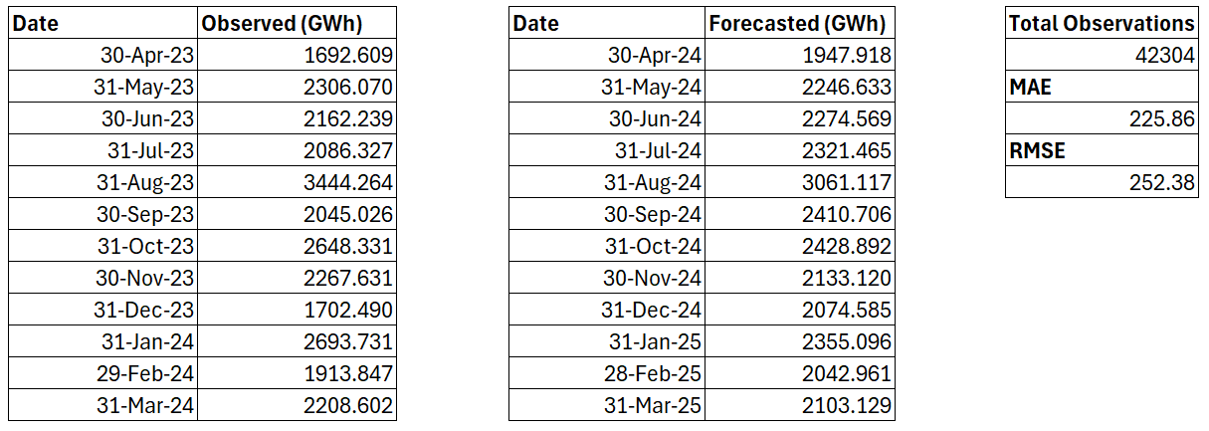
Total Observed | 27,171.17
Total Forecasted | 27,400.190
Difference | 0.84 %

Slide 15
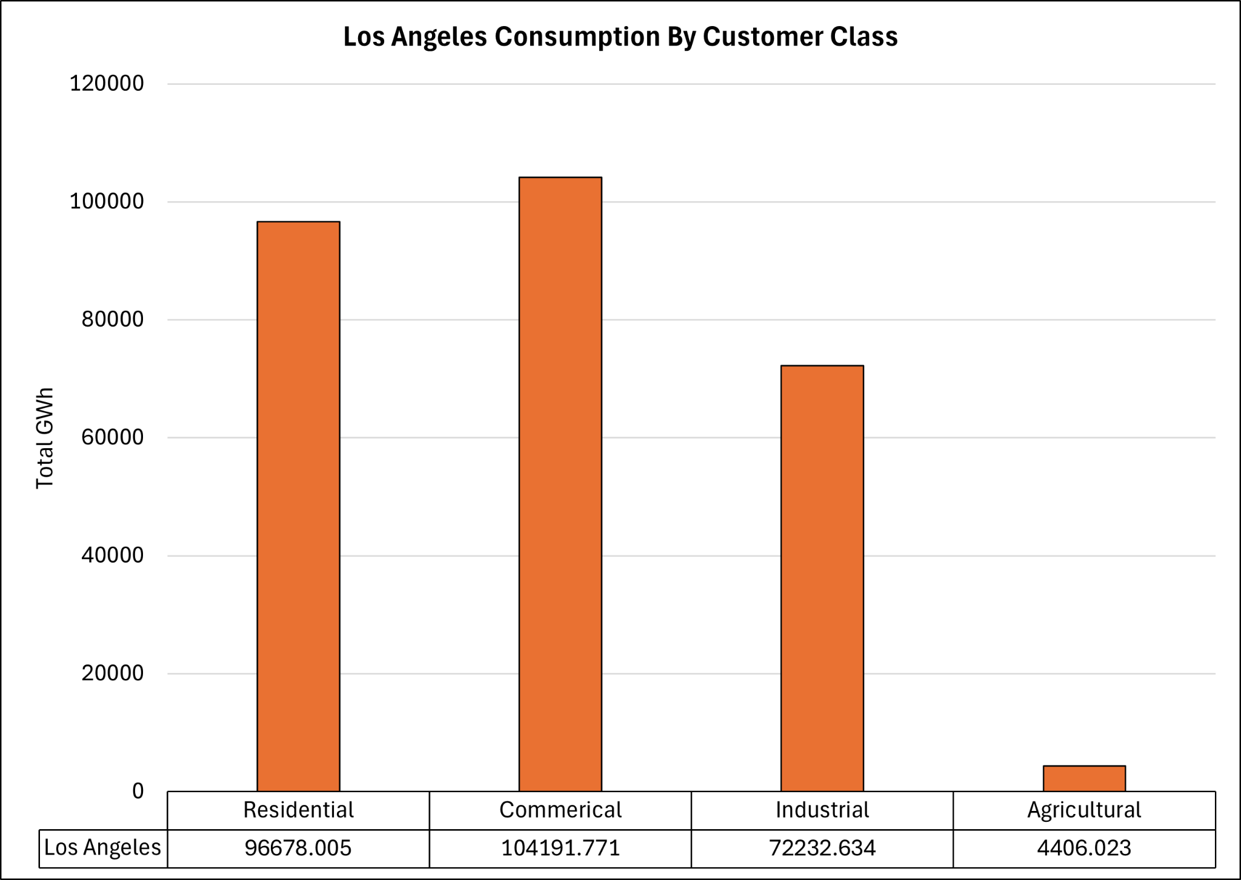

Slide 16
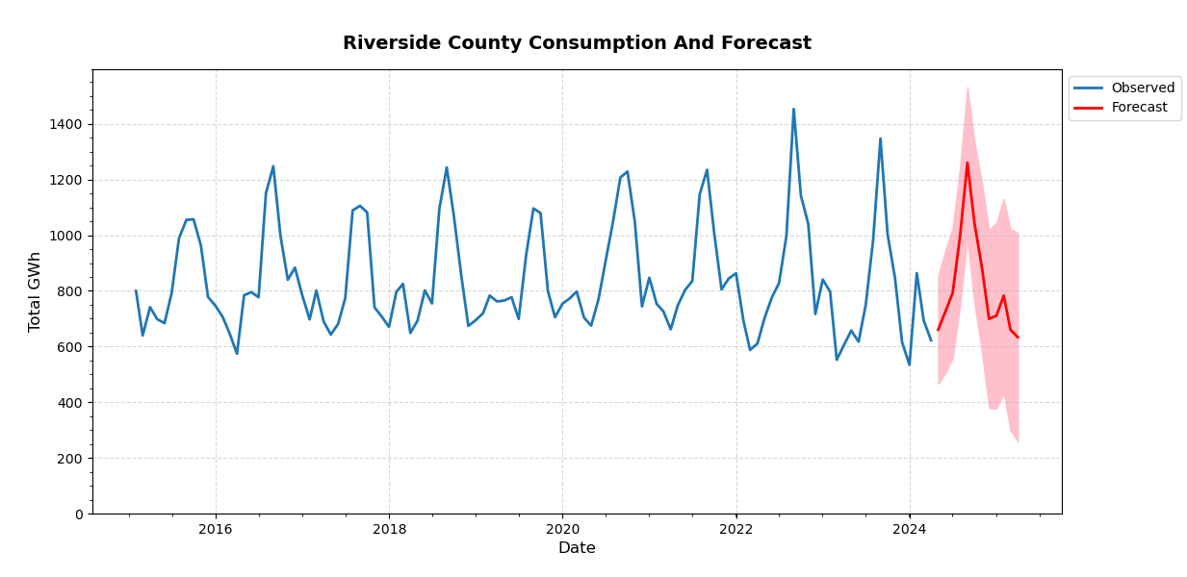
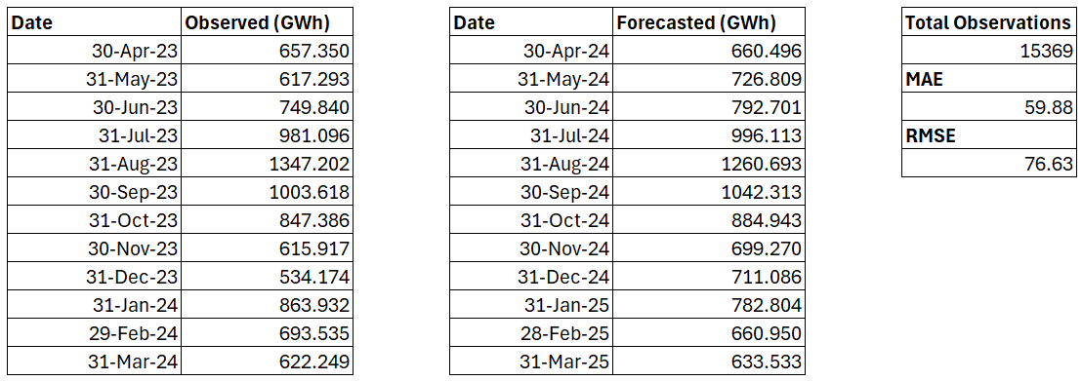
Total Observed | 9,533.59
Total Forecasted | 9,851.71
Difference | 3.34 %

Slide 17
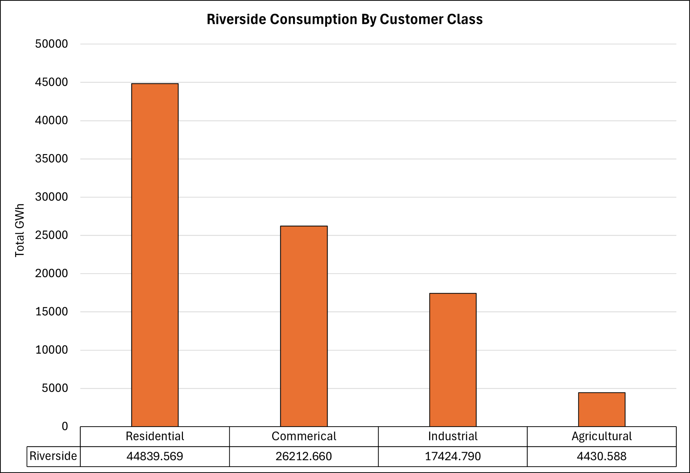

Slide 18
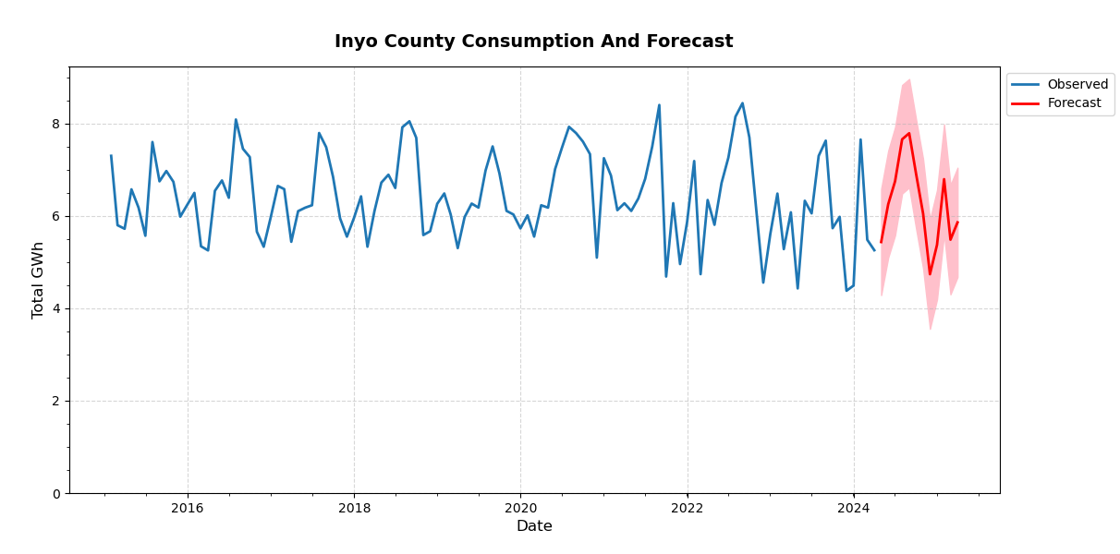
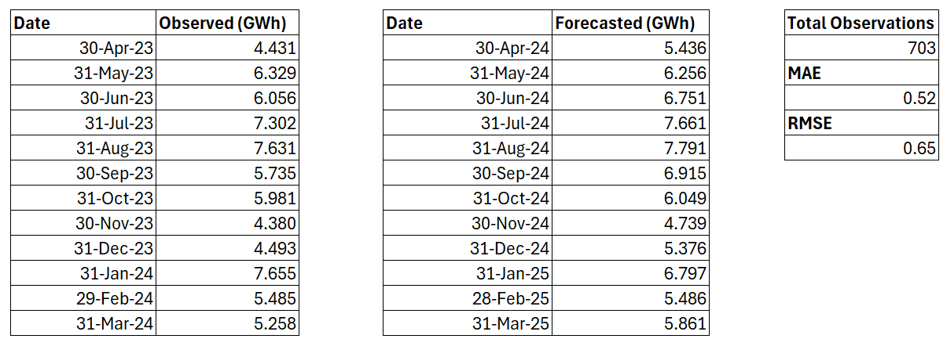
Total Observed | 70.74
Total Forecasted | 75.12
Difference | 6.19 %

Slide 19
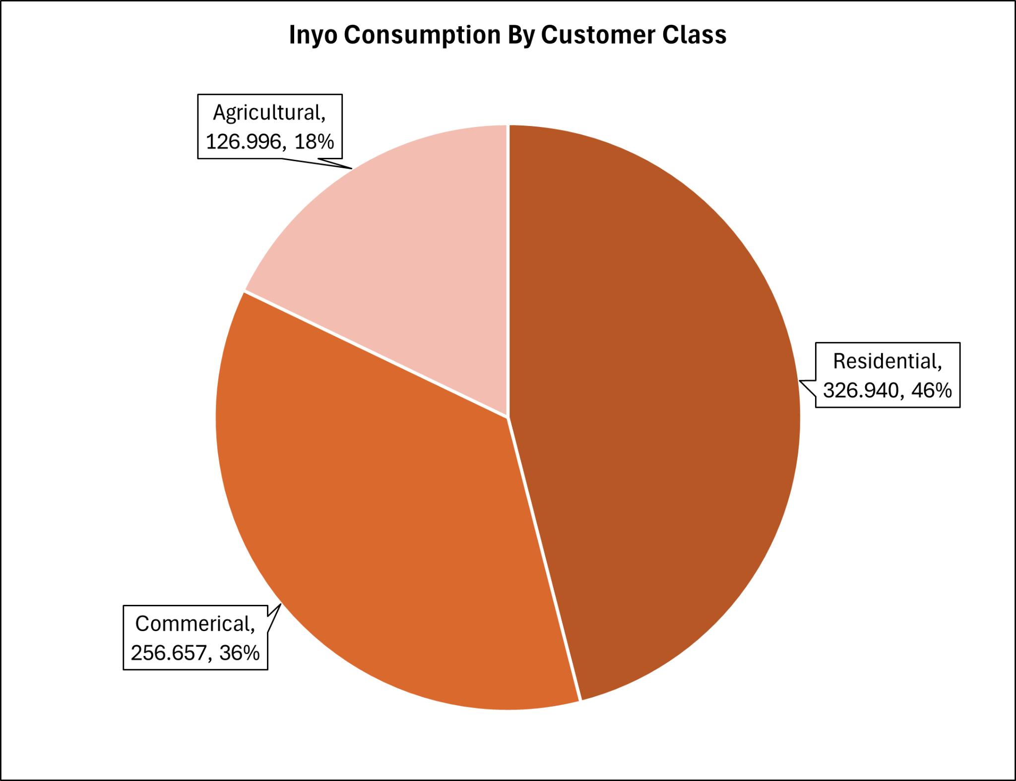

Slide 20
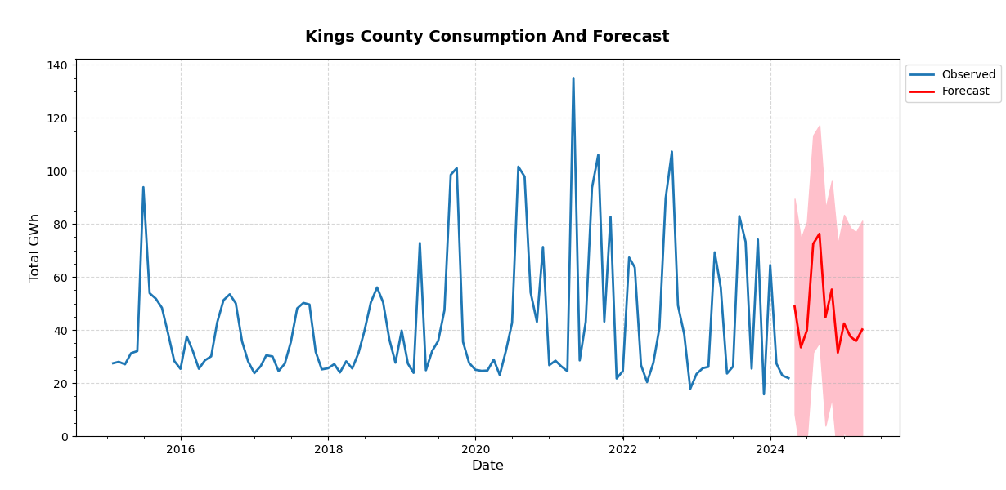
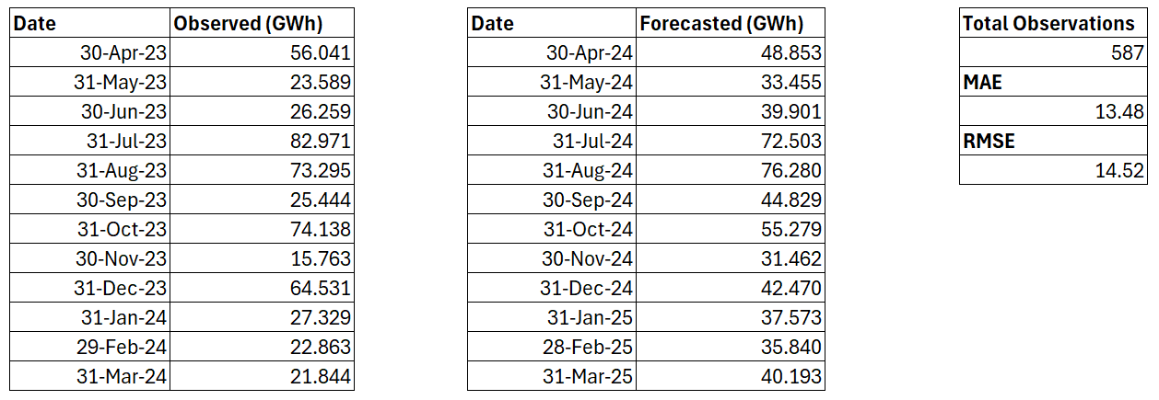
Total Observed | 514.07
Total Forecasted | 558.64
Difference | 8.67 %

Slide 21
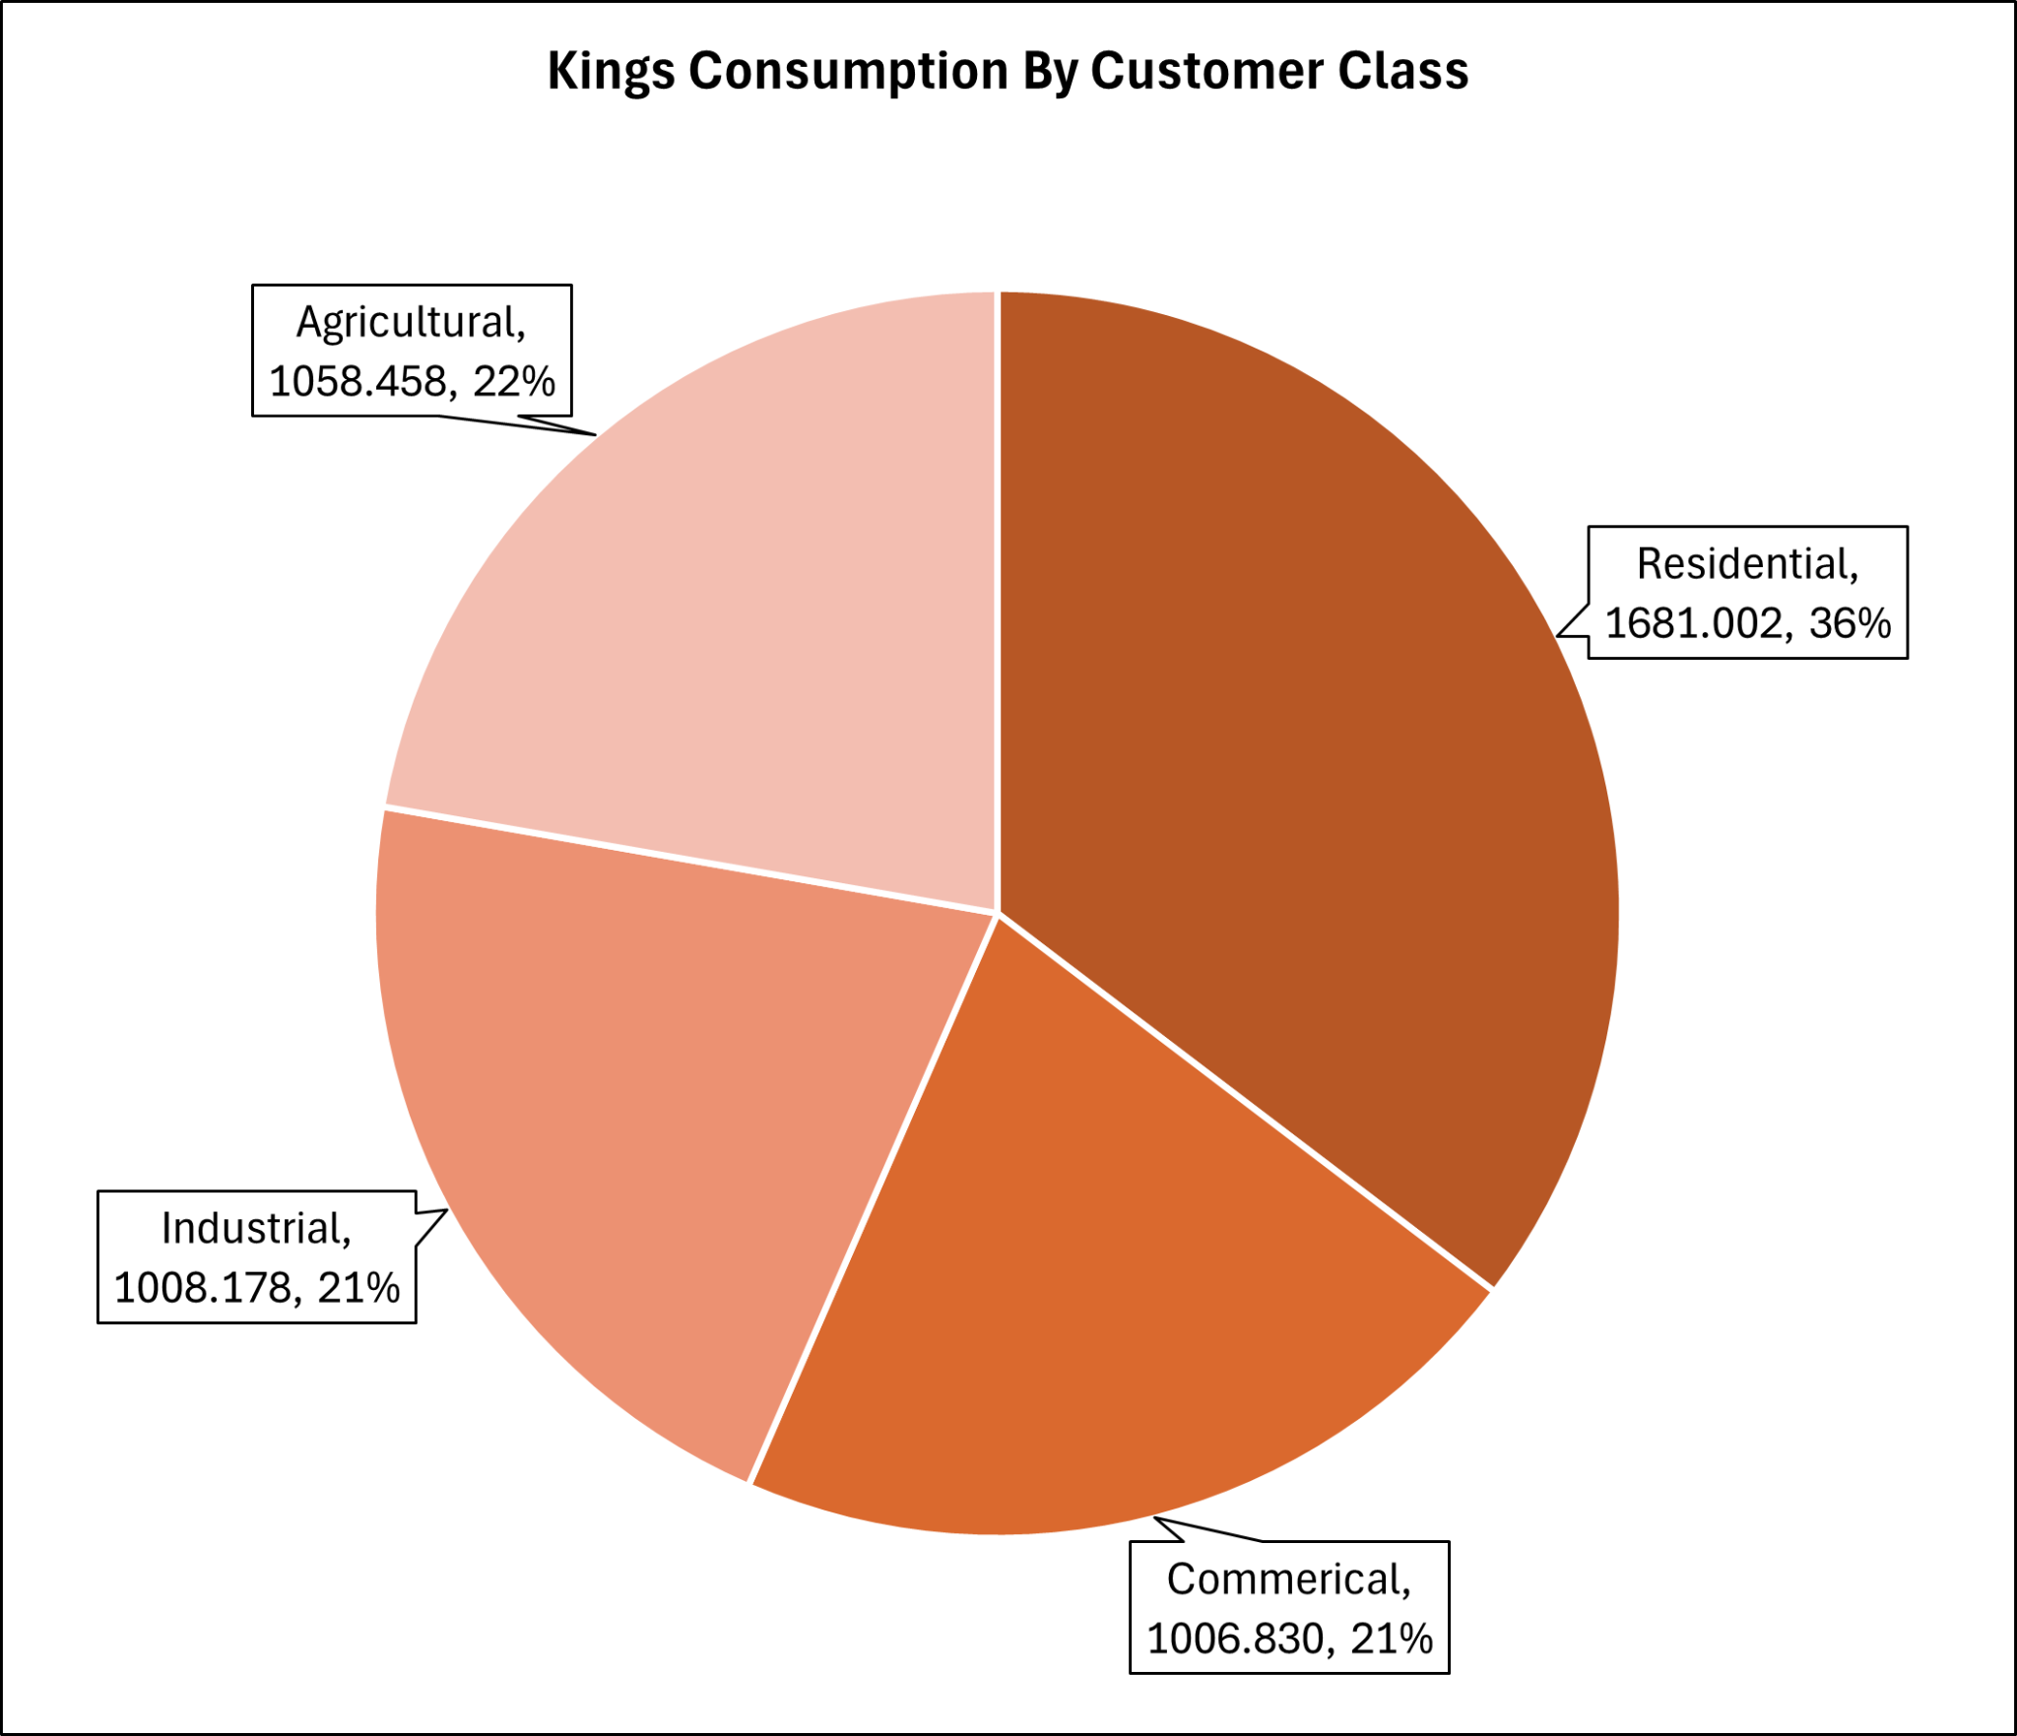

Slide 22
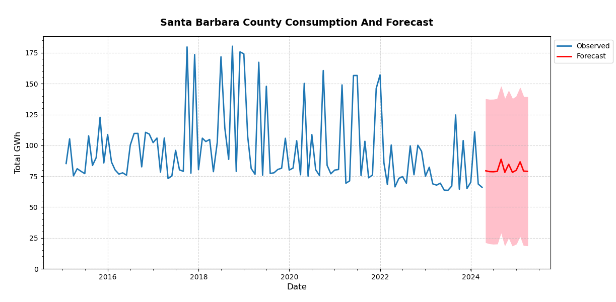
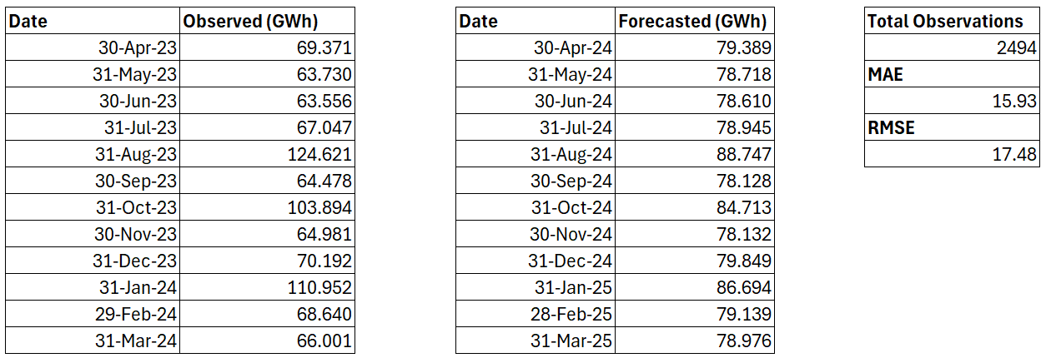
Total Observed | 937.46
Total Forecasted | 970.04
Difference | 3.47 %

Slide 23
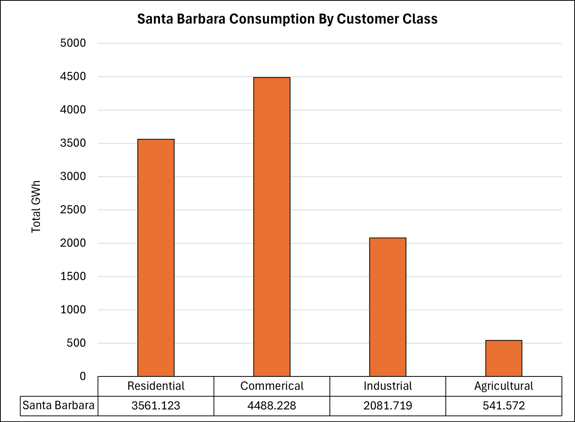

Slide 24
Counties With A Projected Usage Decrease

Slide 25
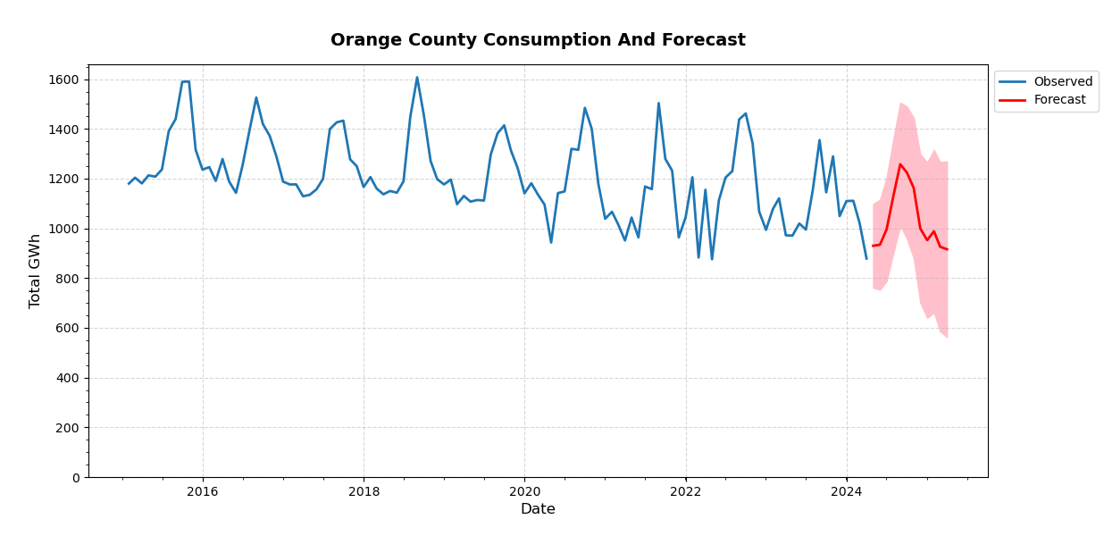
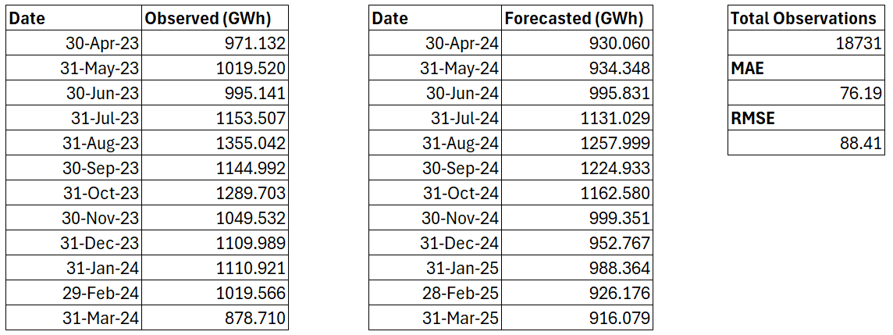
Total Observed | 13,097.75
Total Forecasted | 12,419.52
Difference | - 5.18 %

Slide 26
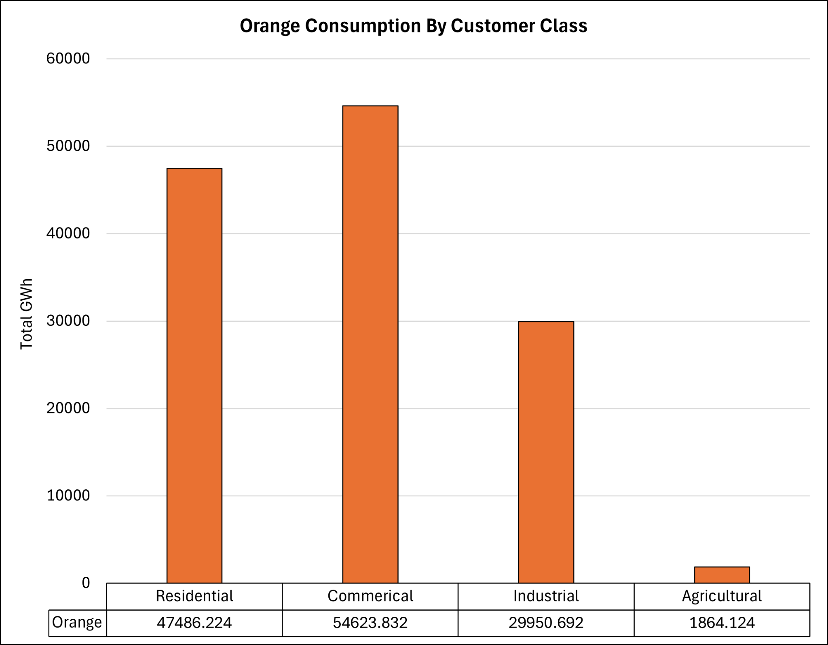

Slide 27
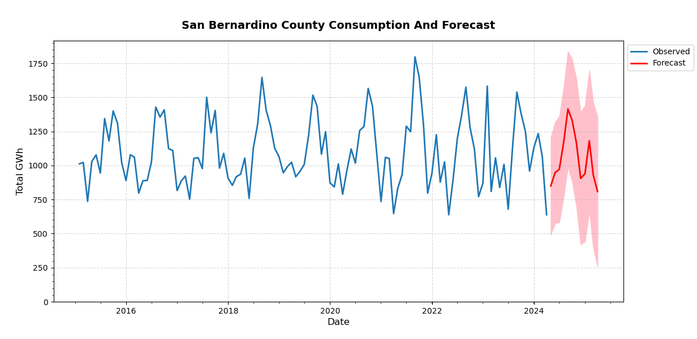
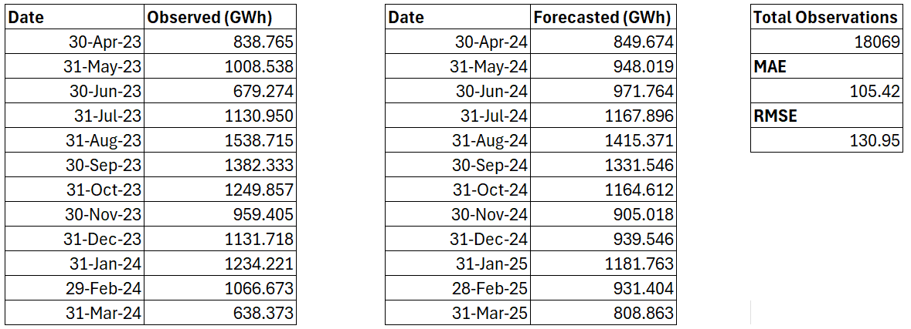
Total Observed | 12,858.82
Total Forecasted | 12,615.48
Difference | - 1.89 %

Slide 28
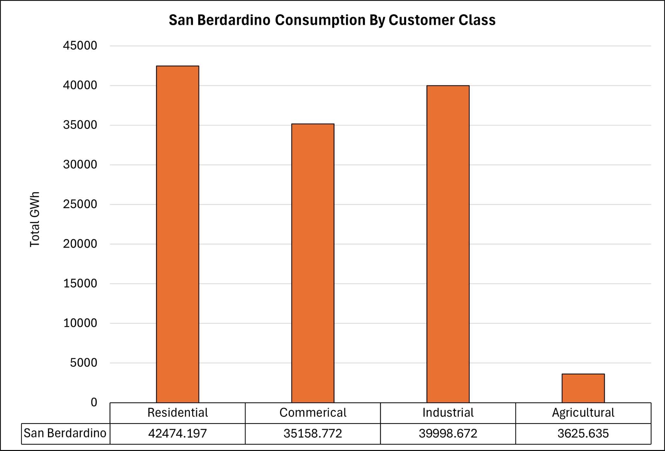

Slide 29
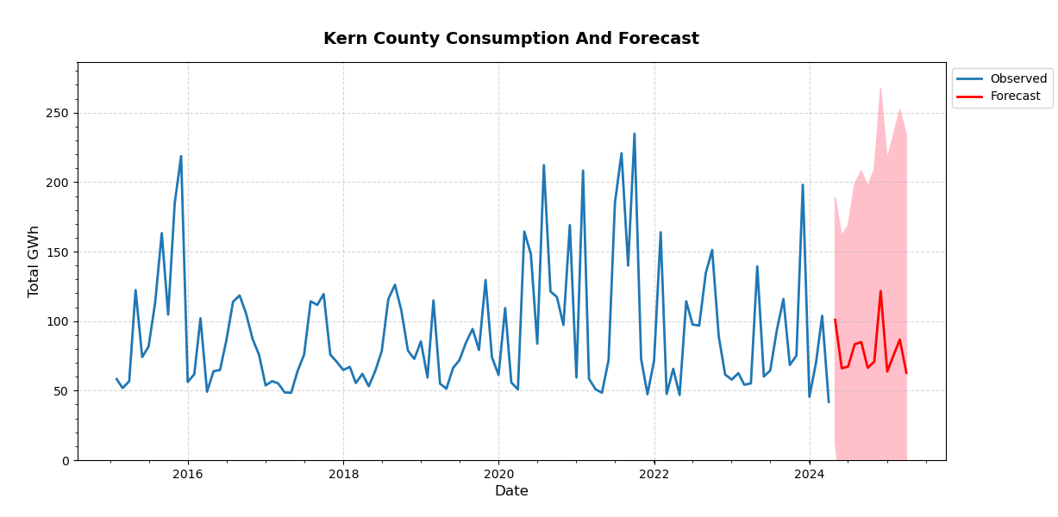
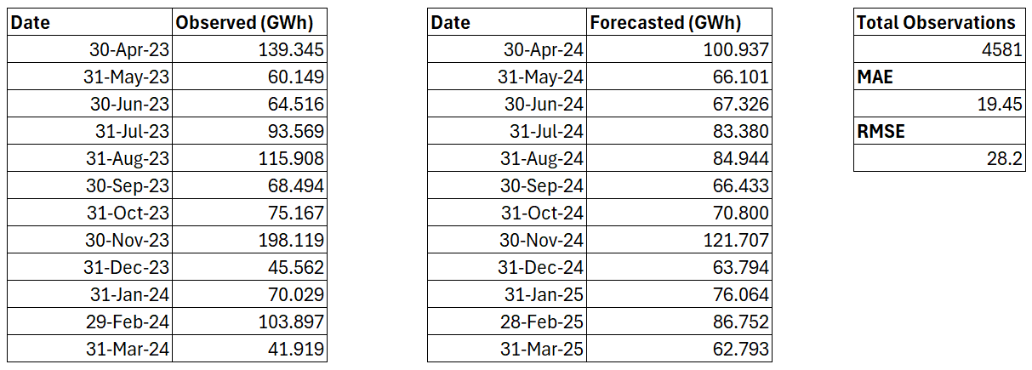
Total Observed | 1,076.68
Total Forecasted | 951.03
Difference (%) | - 11.67

Slide 30
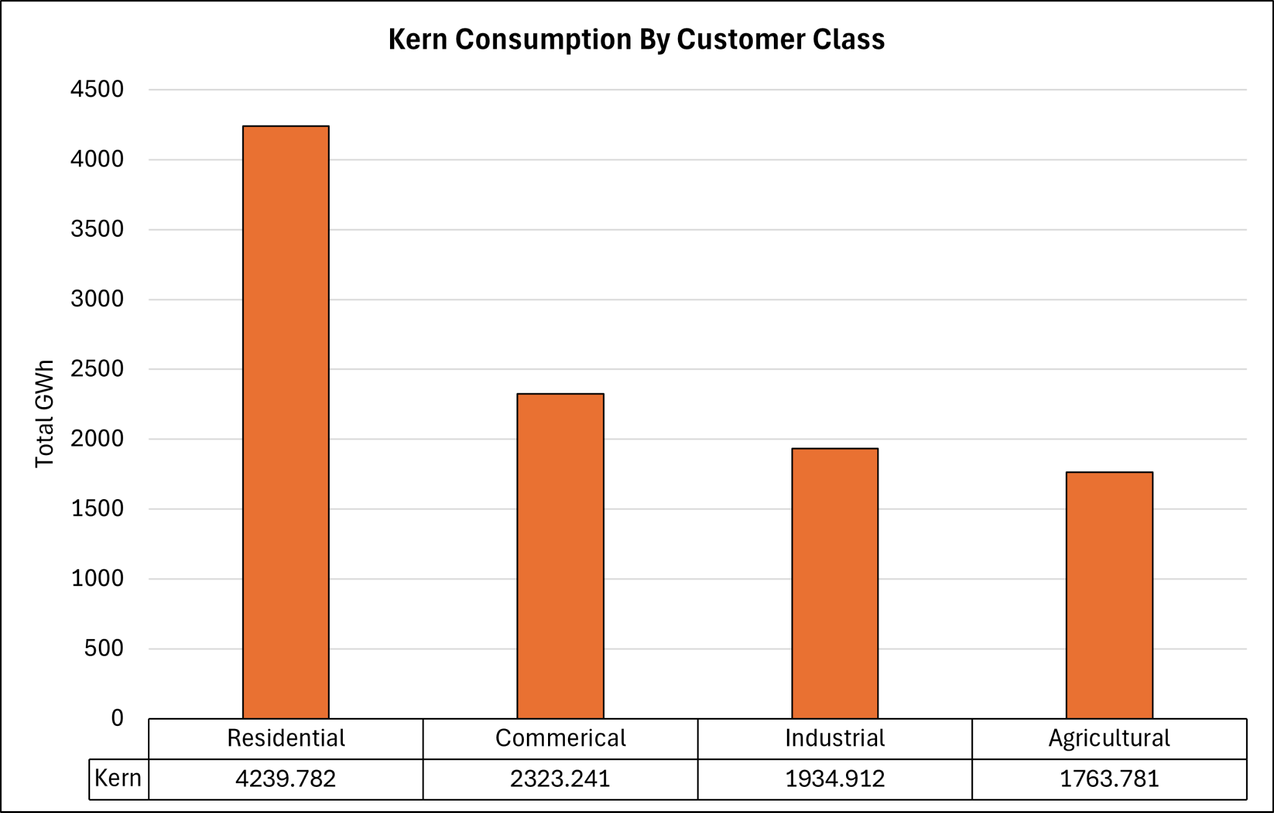

Slide 31
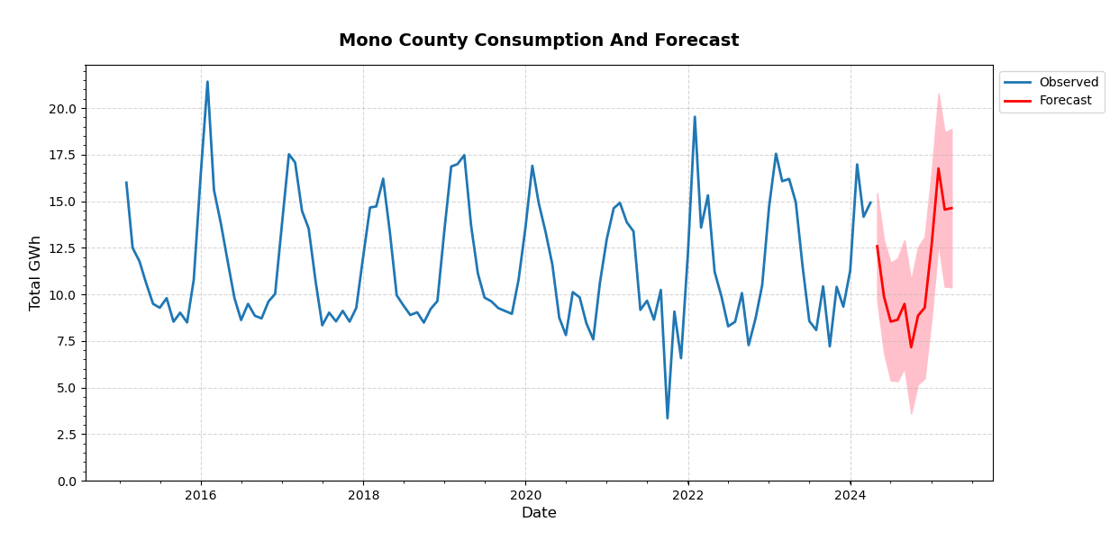
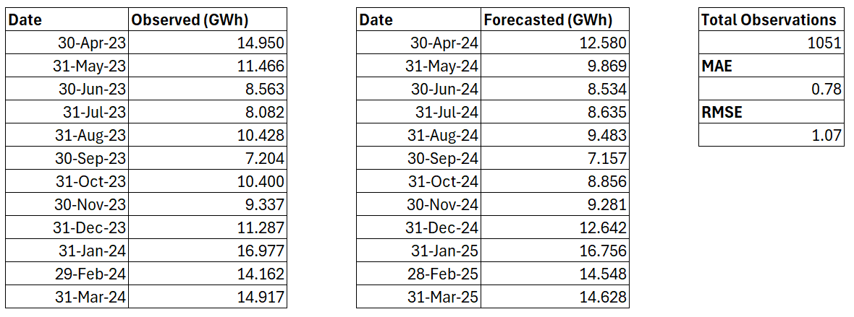
Total Observed | 137.77
Total Forecasted | 132.97
Difference | - 3.49 %

Slide 32
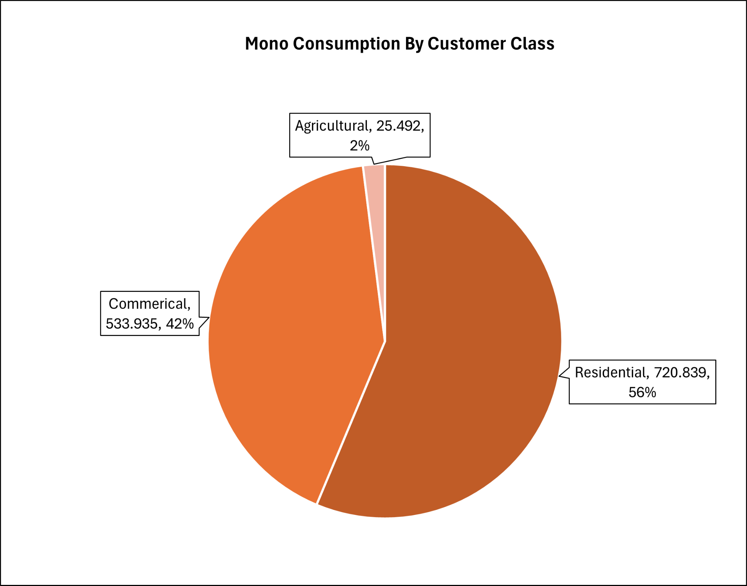

Slide 33
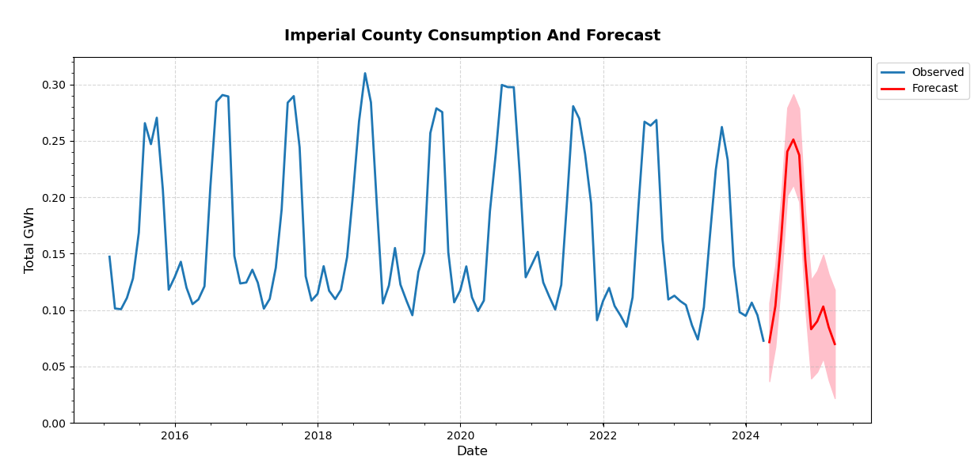
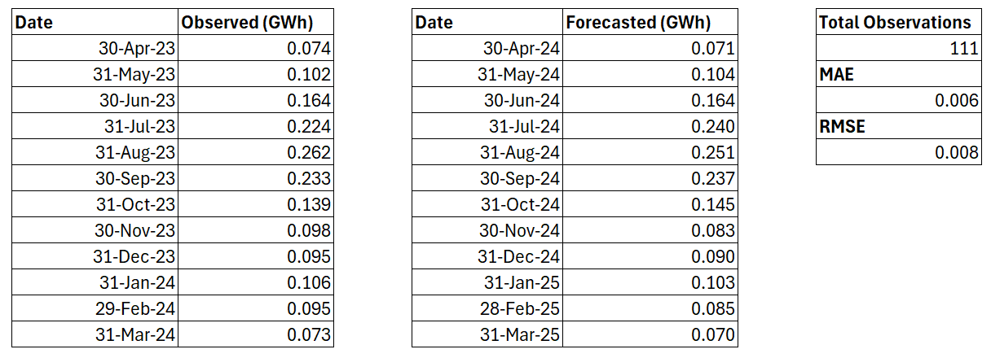
Total Observed | 1.67
Total Forecasted | 1.64
Difference | - 1.41 %

Slide 34
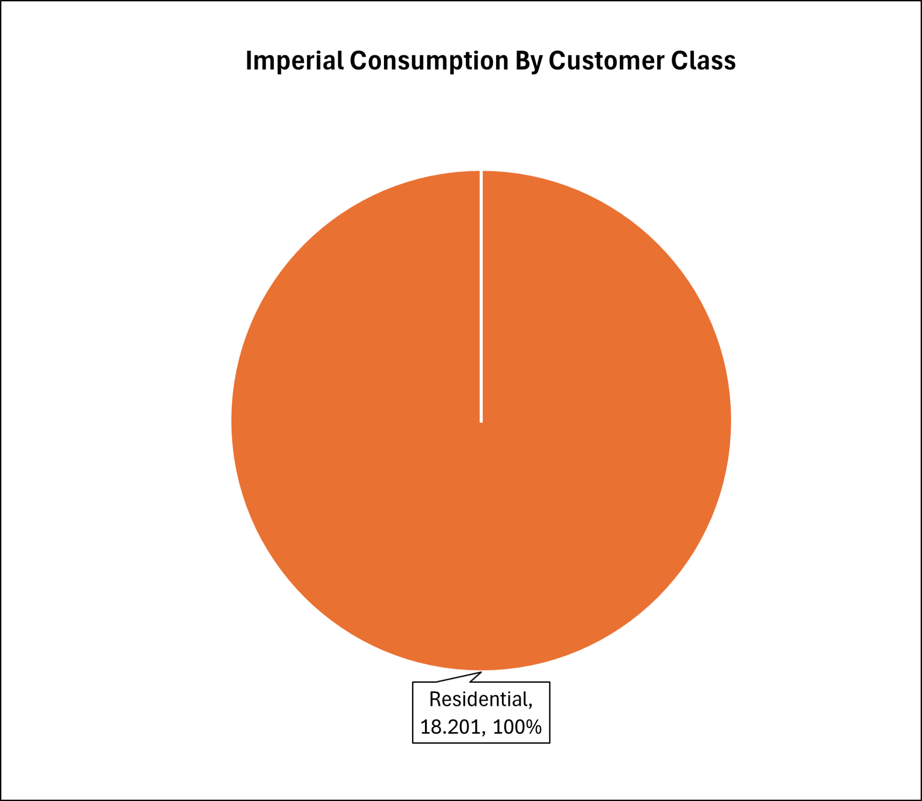

Slide 35
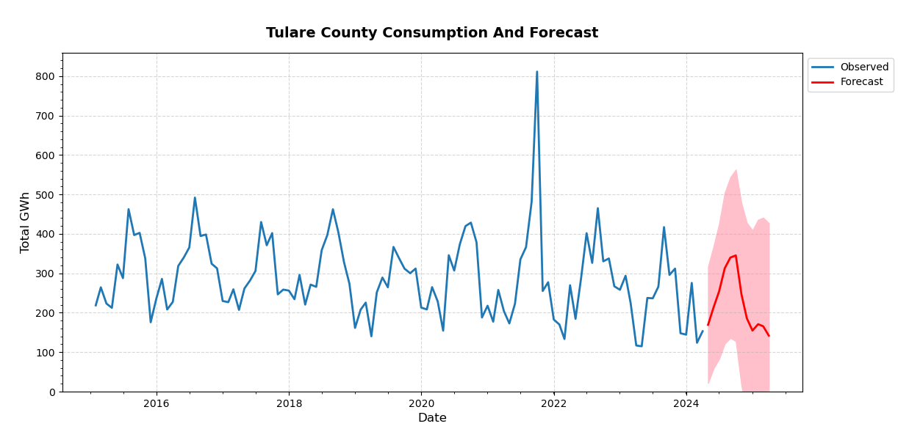
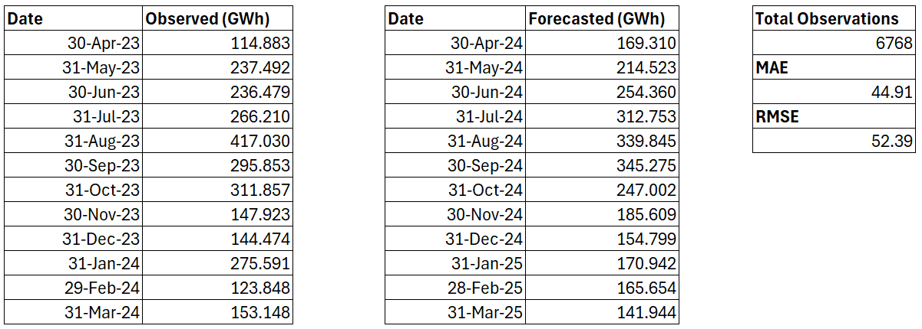
Total Observed | 2,724.79
Total Forecasted | 2,702.02
Difference | - 0.84 %

Slide 36
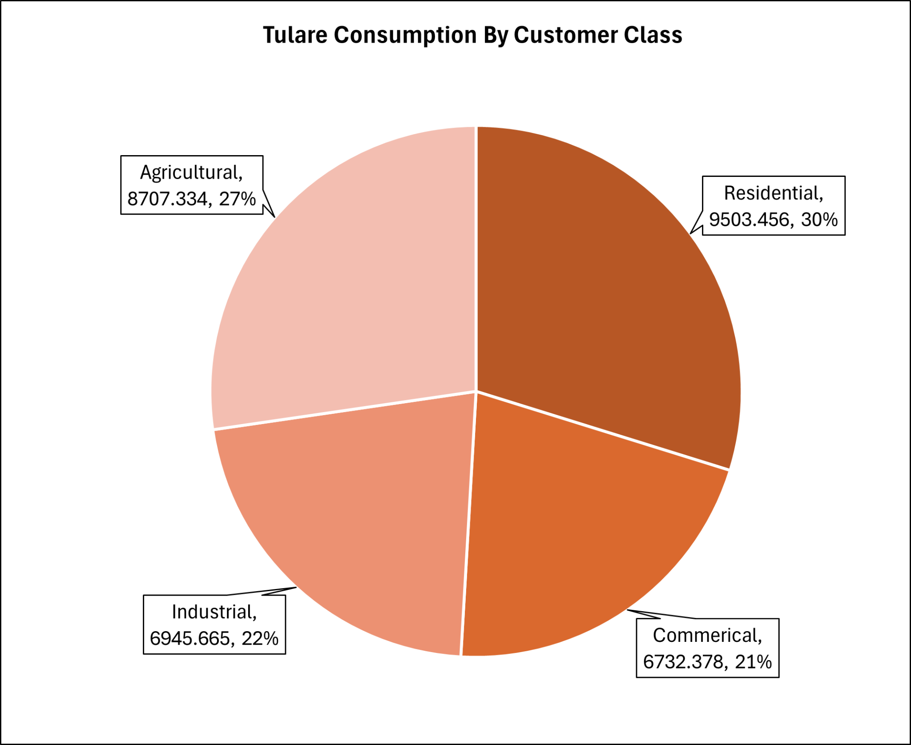

Slide 37
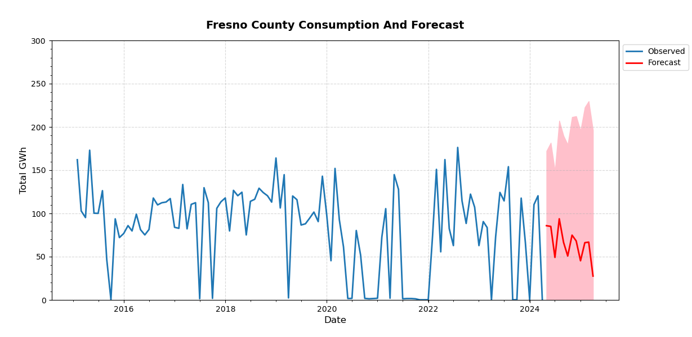
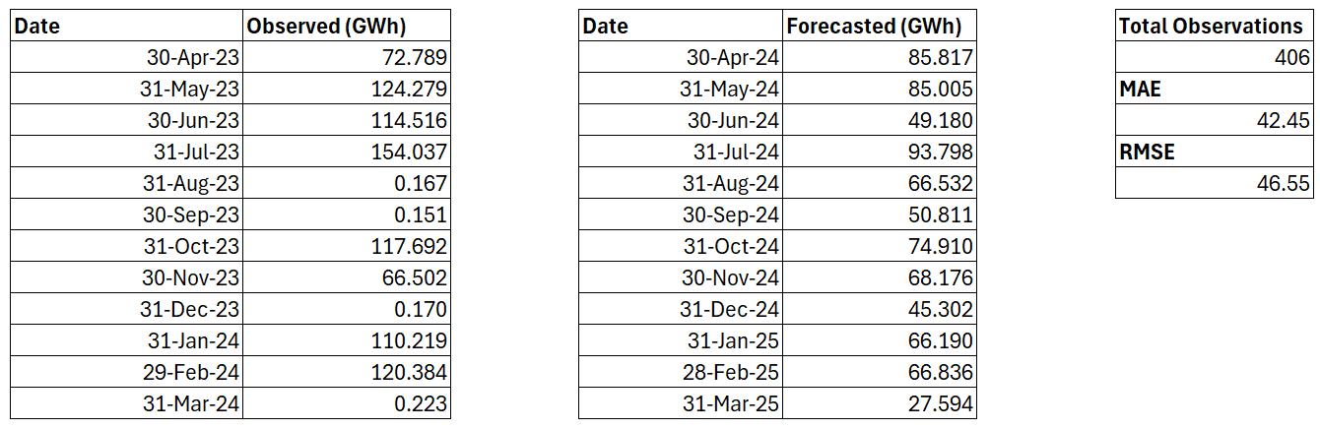
Total Observed | 881.13
Total Forecasted | 780.15
Difference | - 11.46 %

Slide 38
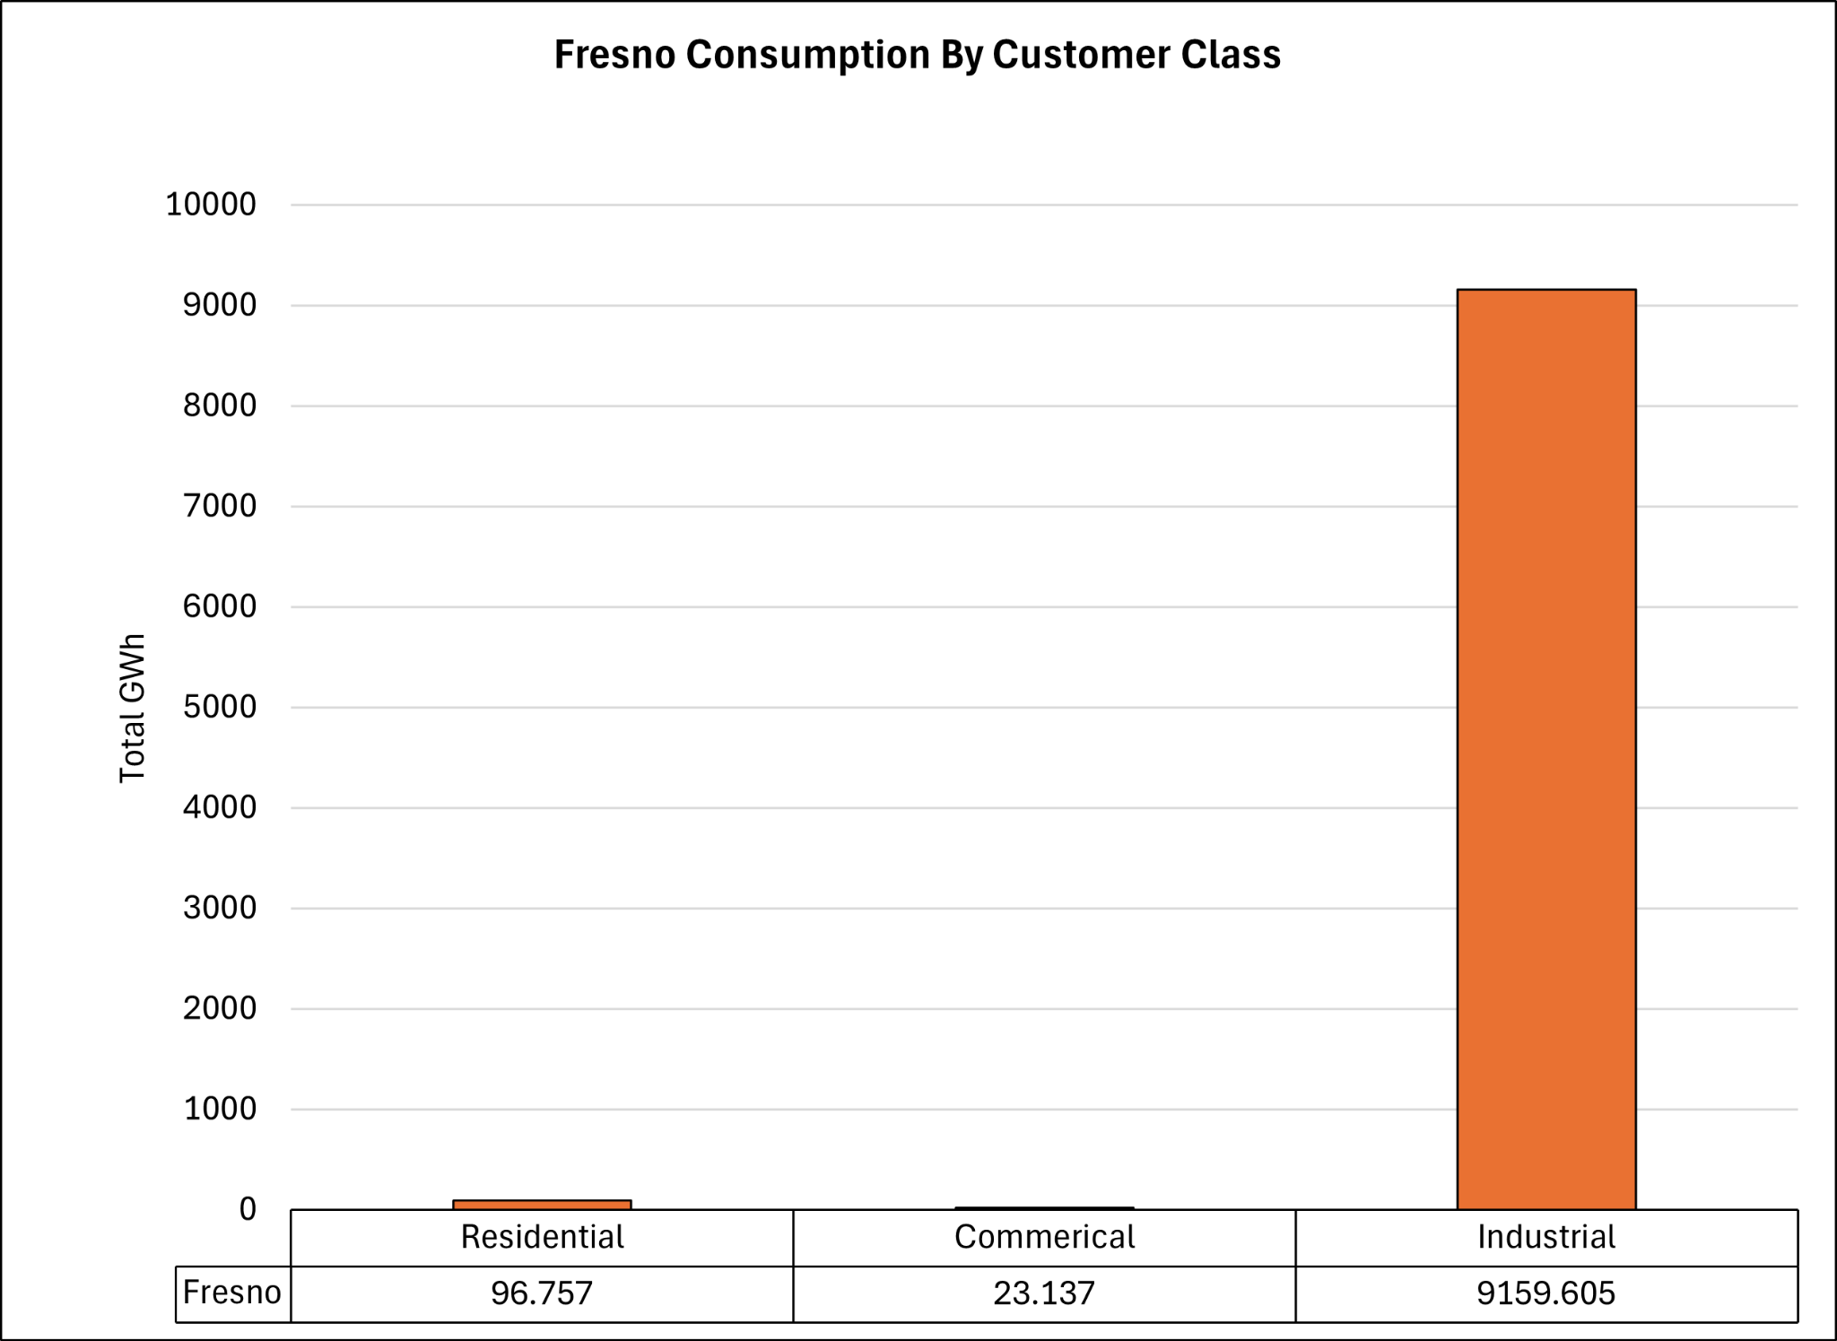

Slide 39
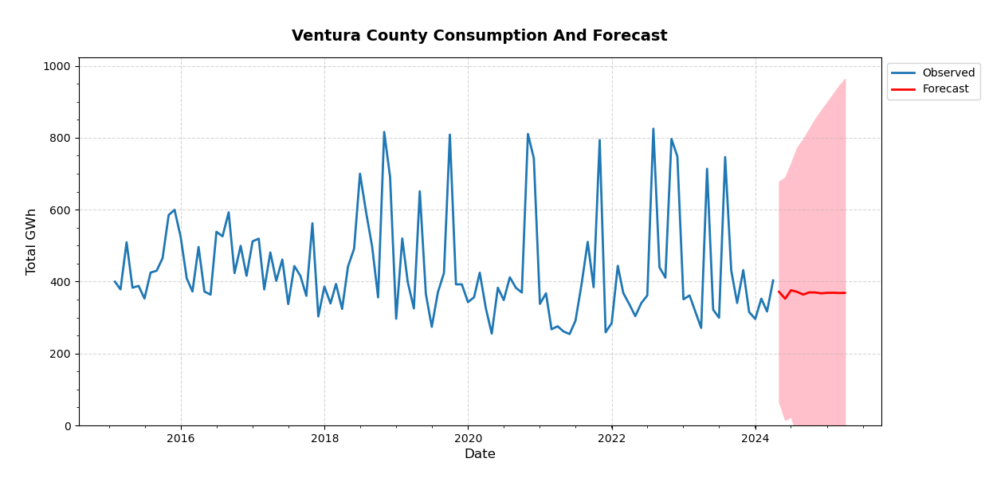
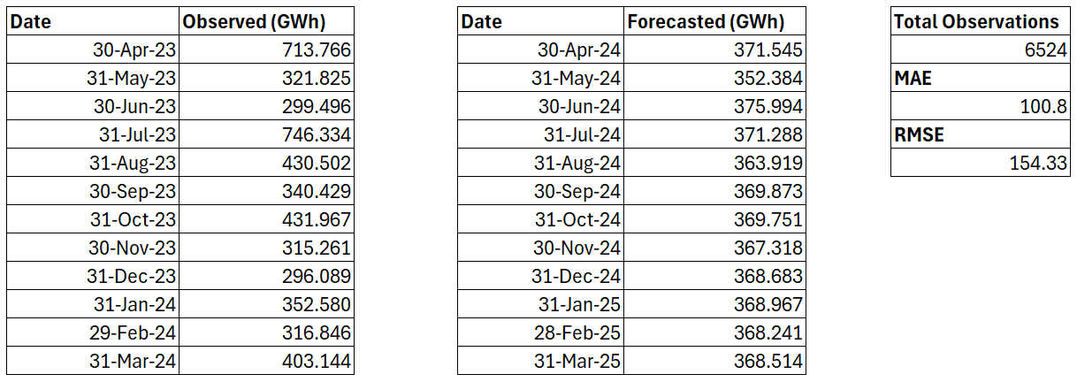
Total Observed | 4,968.24
Total Forecasted | 4,416.48
Difference | - 11.11 %

Slide 40
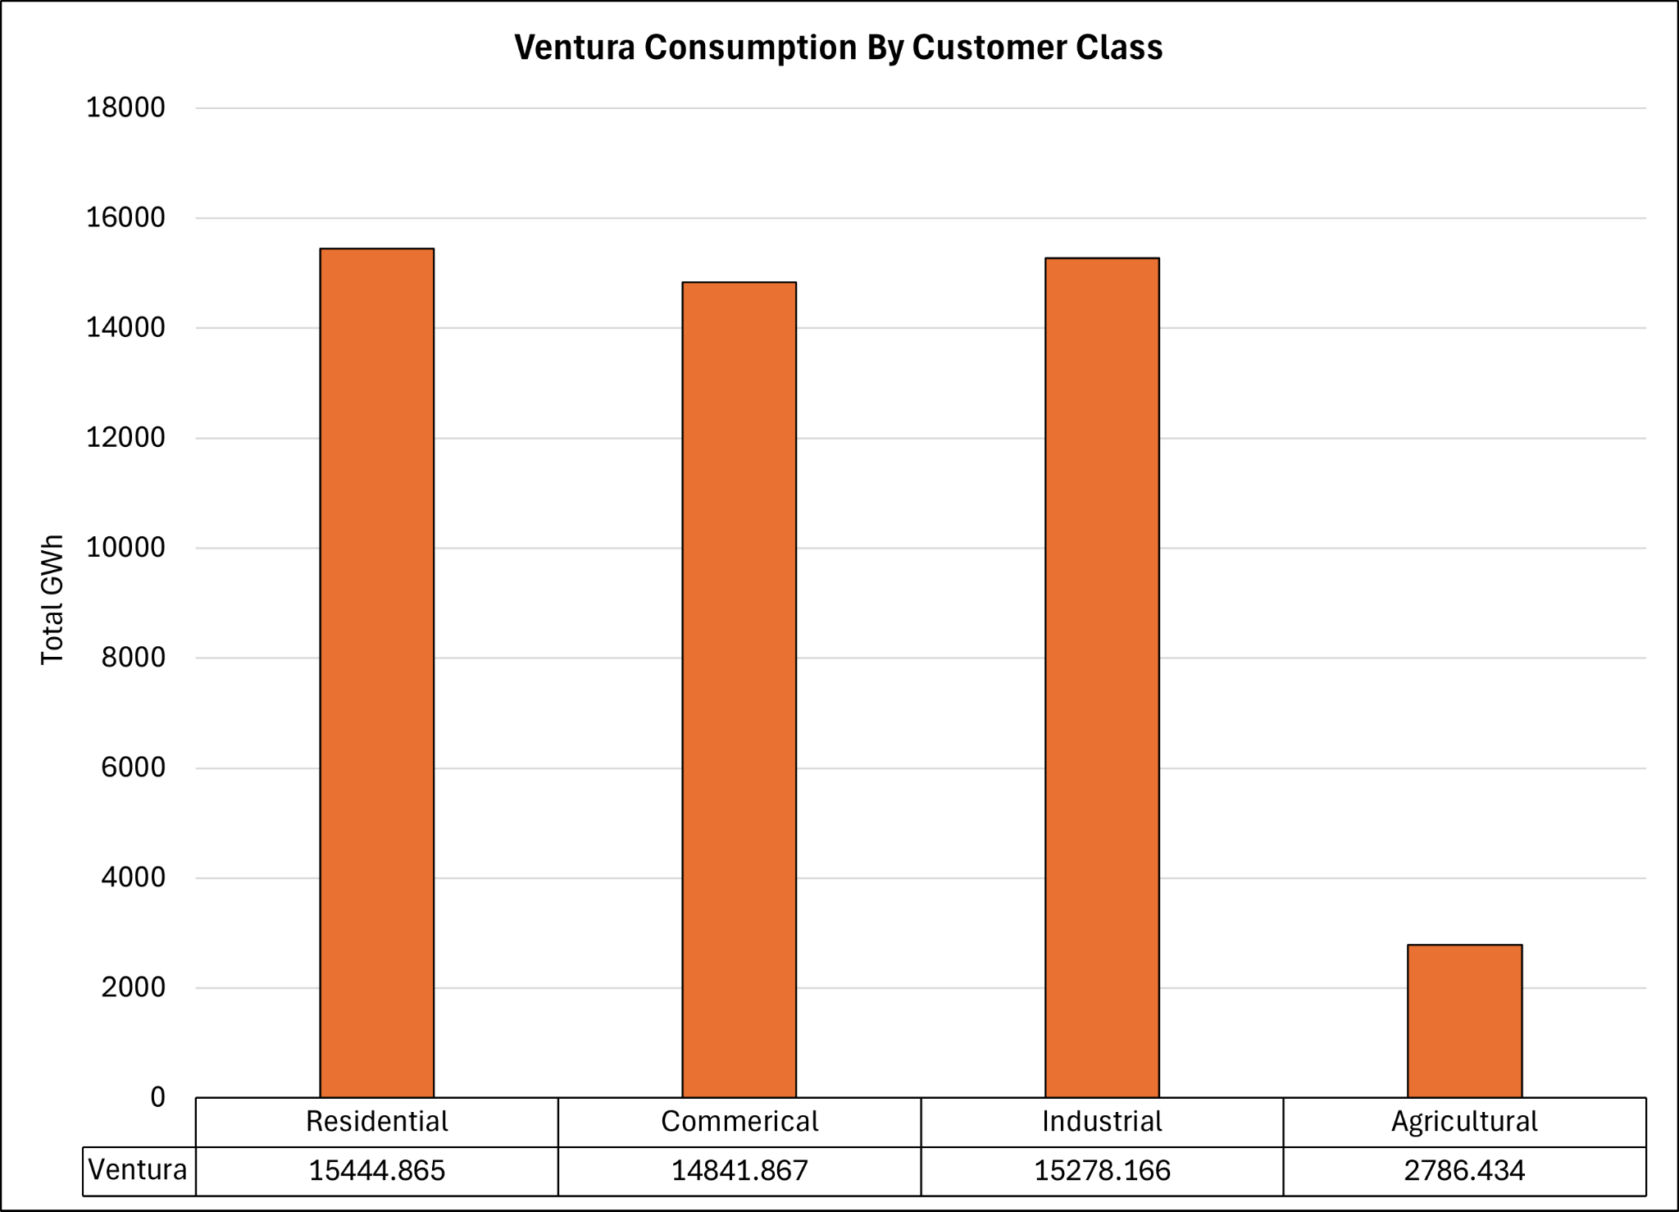

Slide 41

Madera County
Not Enough Data

Slide 42
Summary Of Forecasted Usage Changes
Changes in Counties
Increase
Decrease
Entire SCE coverage combined consumption forecast model estimates an overall 0.78% decrease in the next year (2024.Q2 - 2025.Q1) from the last (2023.Q2 - 2024.Q1)
Orange | -5.18
San Bernardino | -1.89
Kern | -11.67%
Mono | -3.49%
Imperial | -1.41%
Tulare | -0.84%
Fresno | -11.46%
Ventura | -11.11%
Los Angeles | 0.84%
Riverside | 3.34%
Inyo | 6.19%
Kings | 8.67%
Santa Barbara | 3.47%
**Changes are computed from the percentage difference in the total values between forecasted period (2024.Q2 - 2025.Q1) and most recent one-year observed data (2023.Q2 - 2024.Q1)**

Slide 43
Limitations Possibly Affecting Models
Limited Historical Data
Scope
Drastic Seasonality
Unpredictable Events

Slide 44
Resource Allocation Strategies
Involves optimizing operational processes, enhancing customer service, adopting innovative technologies, and promoting sustainability

Slide 45

Data-Driven Decision Making
Use data analytics tools to collect and analyze data on consumption patterns, peak demand time, and customers’ preferences
Predictive analytics to forecast future demand and identify areas for resource optimization
Real-time monitoring systems could help respond to fluctuations in supply and demand

Slide 46
Regulatory Compliance and Risk Management
Requirements
Mitigating Risk
Stay up to date on energy regulation utilities and addresses risks and limitations
Plans related to supply chain disruptions, cyber threats, and natural disasters should be prepared
Notes:
Abhi

Slide 47
Infrastructure Investment
Renewables
Technologies
Distribution
Prioritize investments in renewables to diversify the energy mix and reduce reliance on fossil fuels
Invest in smart grid technologies like advanced metering infrastructure (AMI) and distribution automation, to enable remote monitoring and control of energy distribution
Upgrade transmission and distribution networks to improve efficiency, reliability, and resilience against extreme weather events and cyber threats

Slide 48


Energy Storage Solutions
Battery Storage Solutions:
Lithium-Ion Batteries:
high energy density,fast response times, scalable.
Better for smaller scale projects (residential, commercial, or industrial)
Flow Batteries (vanadium redox):
long cycle life and scalable.
Better for larger scale projects (Grid-scale)
Pumped Hydro Storage Solutions:
Existing Reservoirs:
leverage existing reservoirs and hydroelectric facilities for pumped hydro storage.
New Pumped Storage Projects:
constructing new reservoirs or repurposing existing infrastructure to create a closed-loop pumped hydro storage system.
Significant cost implications

Slide 49

Sustainability Initiatives
Create sustainability goals and include targets for reducing greenhouse gas emissions, increasing renewable energy capacity, and promoting energy efficiency
Interact with stakeholders to support and align with sustainability efforts

Slide 50
Energy-Saving Initiatives
Designing customized energy-saving initiatives for high electricity consumption areas involves a multifaceted approach

Slide 51
Data Analysis & Assessment
Data Collection
Assessment
Collect data on target areas for energy consumption including residential, commercial, and industrial sectors
Identify peak times of energy consumption, major factors to the latter, and areas with most potential to improve

Slide 52
Demand Response & Time-of-Use Pricing
Implement demand response programs to incentivize participants in targeted areas to reduce electricity usage during peak demand periods
Time-of-use pricing plans that encourage customers to shift energy-intensive activities to off-peak hours would reduce strain on the grid and lower energy costs

Slide 53

Monitoring Feedback
Implement real-time monitoring of energy consumption and savings systems to track effectiveness
Provide feedback to participants and stakeholders on energy usage and savings to determine successes and areas for improvement

Slide 54


Incentive Programs
Encourage adoption of energy-efficient technologies
Make sure incentives match the needs and preferences of target demographic such as income level, property household, & customer class

Slide 55

Technology Integration
Introduce energy-efficient technologies such as LED lighting, smart thermostats, and energy-efficient appliances through subsidized or discounted programs
Provide training and support for the installation, operation, and maintenance of these technologies to ensure maximum effectiveness.

Slide 56
Business Energy Assessments & Incentives
Offer financial incentives, rebates, or low-interest loans to businesses for implementing energy-saving measures such as lighting upgrades, equipment optimizations, and building envelope improvements.
Partner with local businesses to conduct energy assessments and identify opportunities for efficiency improvements

Slide 57
Continuous Improvement
Internal Culture Development:
Actively seek feedback from employees
Use suggestion boxes, forums, and recognition programs
Incentivize and reward innovative ideas and contributions
Cross-Sector Collaboration:
Collaborate with research institutions, universities, and startups
Exchange ideas, share knowledge, and collaborate on research and develop initiatives
Training and Development:
Invest in training and development programs to enhance employees
Provide workshops, seminars, and conferences focus on the and emerging technology within the energy industry
Data-Decision Making:
Leverage data analytics, machine learning, and predictive modeling techniques to identify opportunities for optimization and efficiency improvement.

Slide 58
Policy Support
Advocacy
What does it include?
Get support for policies at local, regional, and national levels to create an enabling environment for energy conservation
Building codes that mandate energy-efficient construction standards, incentives for renewable energy adoption, or demand-side

Slide 59


Partnerships and Collaboration
Government Agency Collaborations:
Collaborate with government agencies at the local, state, and federal levels to align efforts in promoting energy efficiency, renewable energy adoption, and regulatory compliance.
Benefits: Regulatory Compliance and Support, Access to Funding and Incentives, Public Policy Advocacy
Non-Profit Organization Partnerships:
Partner with non-profit organizations focused on sustainability, energy conservation, and community development to leverage their expertise, networks, and community outreach capabilities. (Environmental Defense Fund, Sierra Club, Alliance to Save Energy)
Benefits: Access to Expertise and Resources, Expanded Reach and Community Engagement, Enhanced Credibility and Trust
Notes:
Access to Expertise and Resources: Partnering with nonprofits allows SoCal Edison to tap into their specialized knowledge, expertise, and resources in areas such as energy efficiency, renewable energy, community engagement, and environmental advocacy. This can enhance the effectiveness and impact of SoCal Edison's initiatives and programs.
Expanded Reach and Community Engagement: Nonprofit organizations often have established networks and relationships within the communities they serve. By partnering with these organizations, SoCal Edison can expand its reach and engage with a broader and more diverse audience, including underserved communities and stakeholders who may not typically interact with the utility.
Enhanced Credibility and Trust: Collaborating with reputable nonprofits can enhance SoCal Edison's credibility and trustworthiness, particularly among stakeholders who value environmental stewardship and social responsibility. This can strengthen SoCal Edison's brand reputation and foster positive relationships with customers, regulators, and the broader community.
Innovation and Collaboration Opportunities: Partnerships with nonprofits provide opportunities for innovation and collaboration on new initiatives, pilot projects, and research endeavors. By working together, SoCal Edison and nonprofit partners can develop and implement innovative solutions to energy-related challenges, driving progress towards sustainability goals.
Regulatory and Policy Support: Nonprofit organizations often play a significant role in shaping energy policy and regulatory frameworks. Collaborating with these organizations can help SoCal Edison navigate complex regulatory landscapes, advocate for favorable policies, and demonstrate its commitment to advancing environmental and social objectives.

Slide 60
THANK YOU

